Slide 1
Unscented Kalman Filter

Slide 2
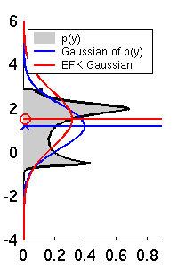
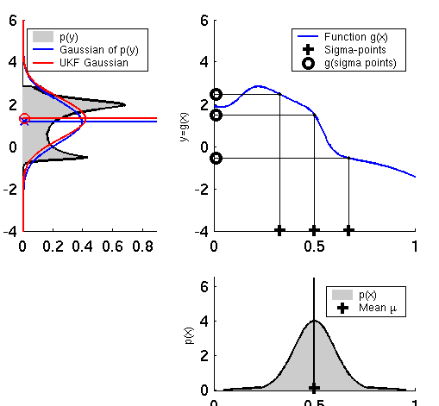
Linearization via Unscented Transform
EKF
UKF

Slide 3
Unscented Transform
intuition: it should be easier to approximate a given distribution than it is to approximate an arbitrary non-linear function
  it is easy to transform a point through a non-linear function
  use a set of points that capture the mean and covariance of the distribution, transform the points through the non-linear function, then compute the (weighted) mean and covariance of the transformed points

Slide 4
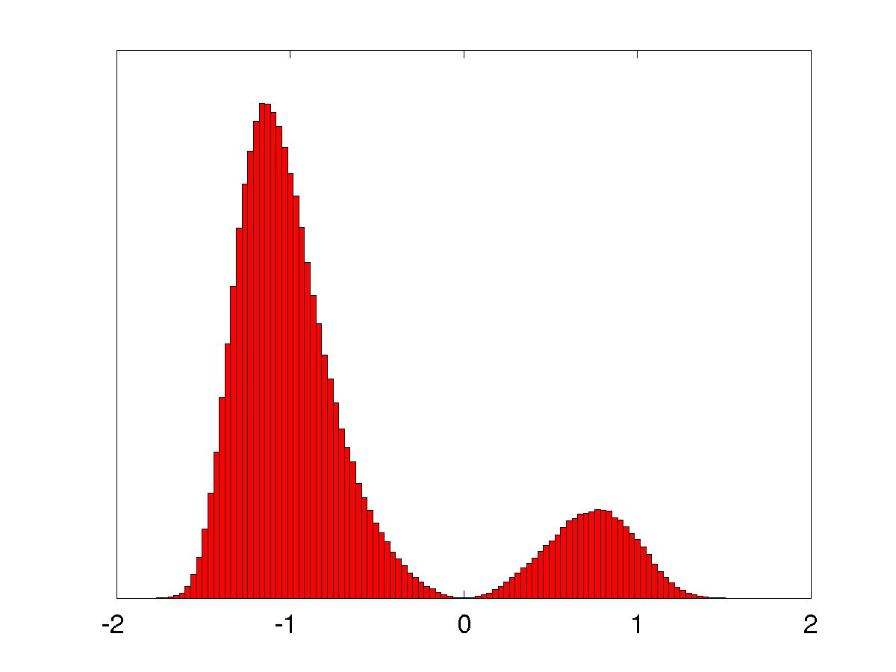
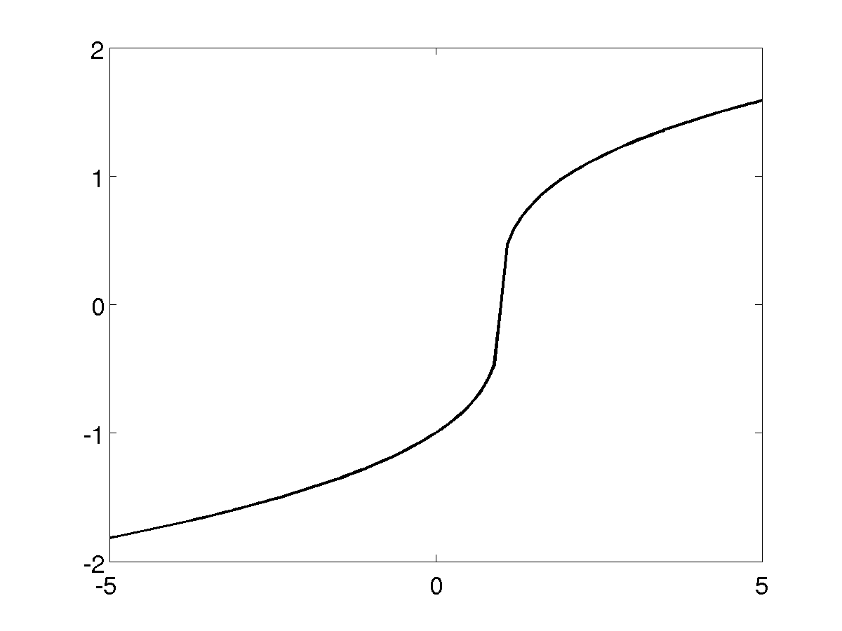
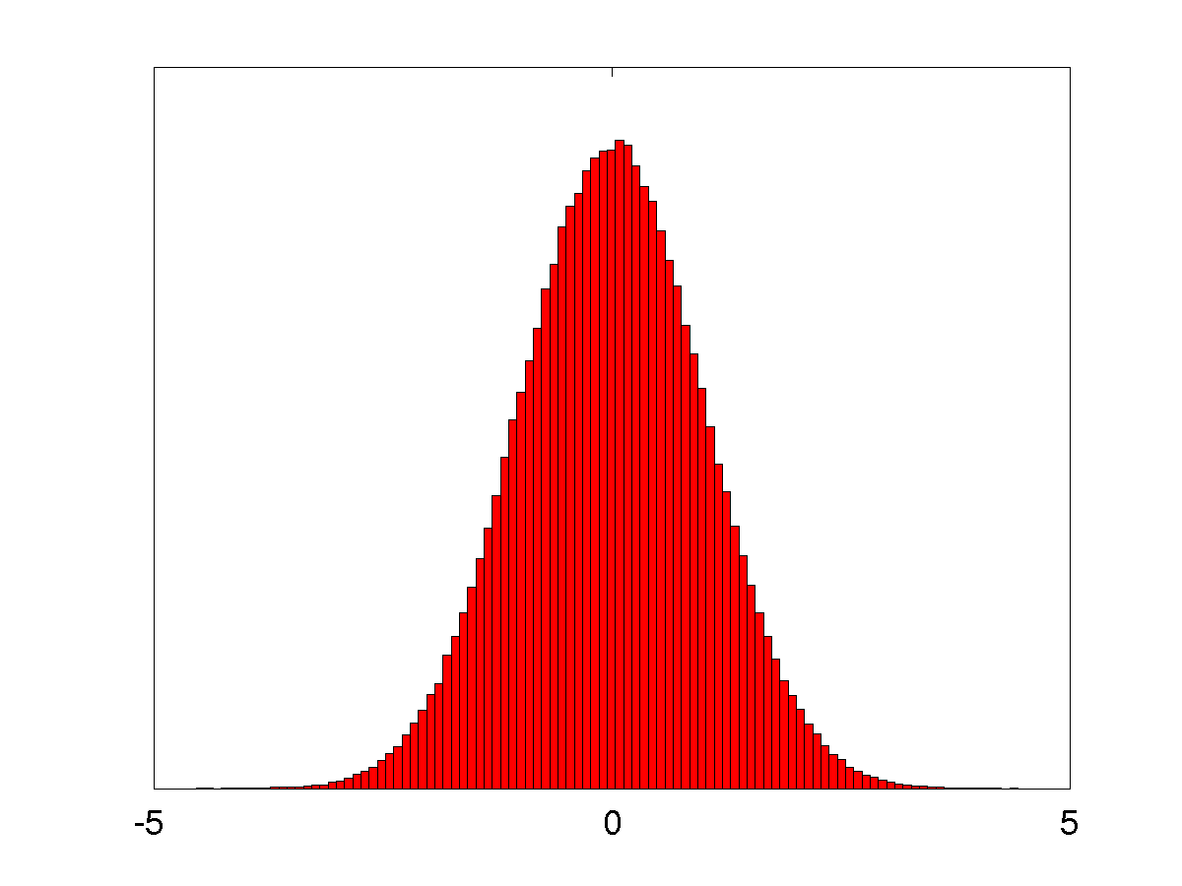
Unscented Transform

Slide 5
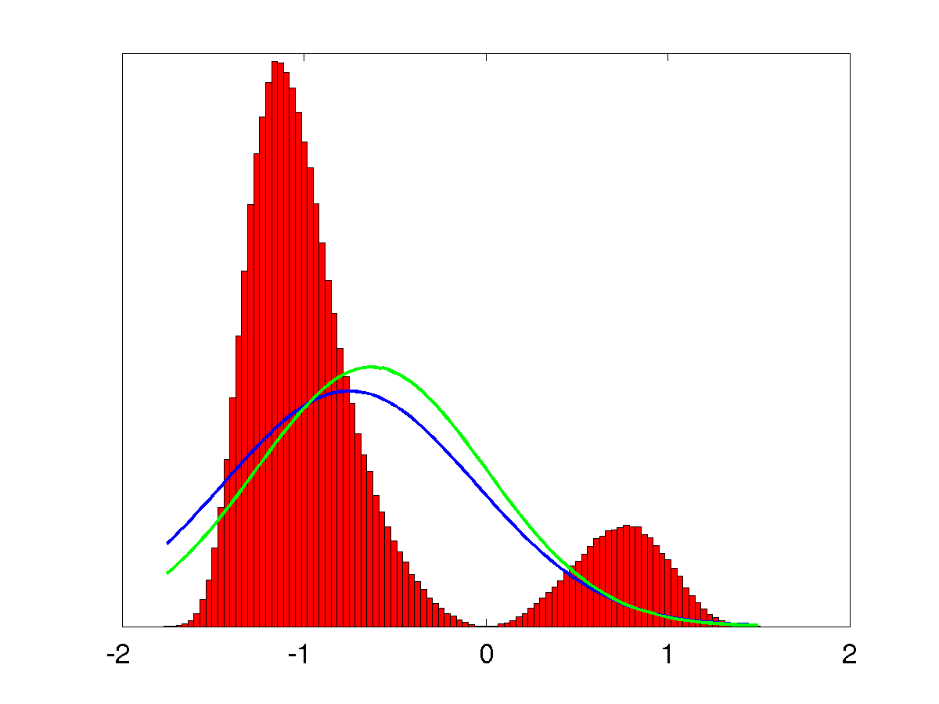
Unscented Transform

Slide 6
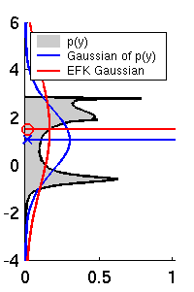
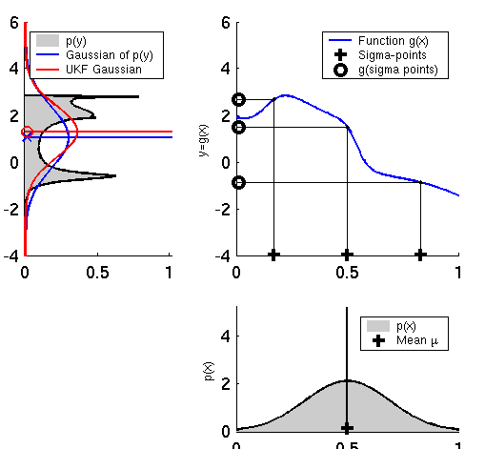
UKF Sigma-Point Estimate (2)
EKF
UKF

Slide 7
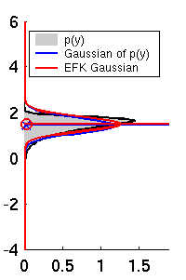
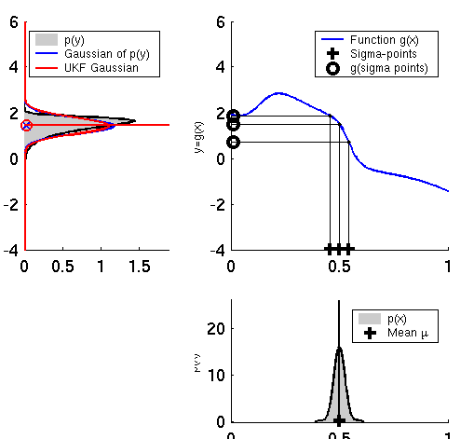
UKF Sigma-Point Estimate (3)
EKF
UKF

Slide 8
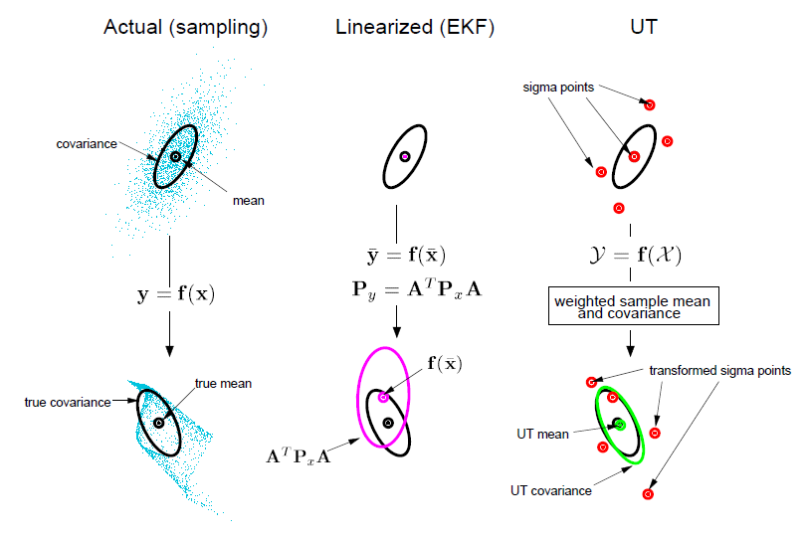
UKF Sigma-Point Estimate (4)

Slide 9
Unscented Transform
for an n-dimensional Gaussian with mean μ and covariance Σ , the unscented transform uses 2n+1 sigma points (and associated weights)
Sigma points Weights

Slide 10
Unscented Transform
choose κ ≥ 0 to guarantee a “reasonable” covariance matrix
  value is not critical, so choose κ = 0 by default
choose 0 ≤ α ≤ 1
  controls the spread of the sigma point distribution; should be small when nonlinearities are strong
choose β ≥ 0
  β = 2 is optimal if distribution is Gaussian

Slide 11
Unscented Transform
Pass sigma points through nonlinear function
Recover mean and covariance

Slide 12
UKF_localization ( μ_{t-1}, Σ_{t-1}, u_{t}, z_{t}, m):
Prediction:
Motion noise
Measurement noise
Augmented state mean
Augmented covariance
Sigma points
Prediction of sigma points
Predicted mean
Predicted covariance

Slide 13
UKF_localization ( μ_{t-1}, Σ_{t-1}, u_{t}, z_{t}, m):
Correction:
Measurement sigma points
Predicted measurement mean
Pred. measurement covariance
Cross-covariance
Kalman gain
Updated mean
Updated covariance

Slide 14
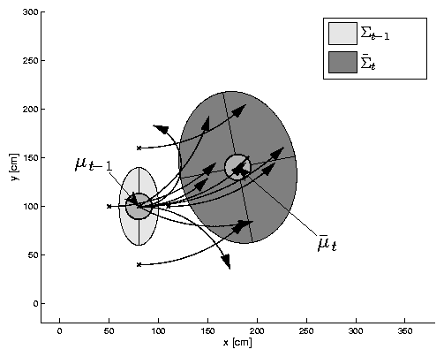
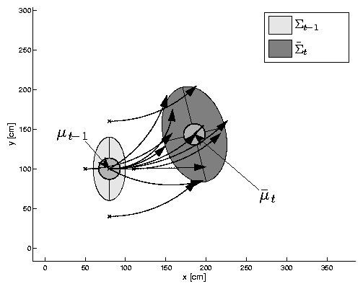
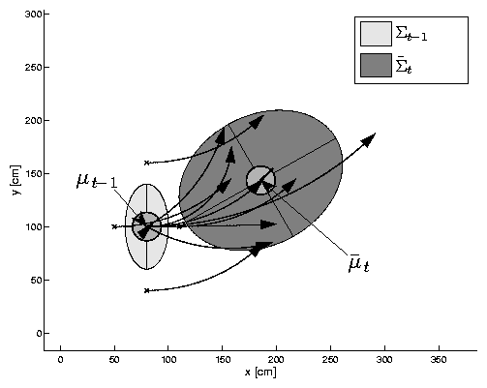
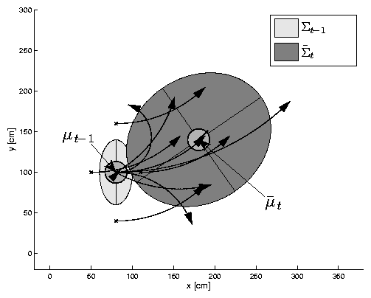
UKF Prediction Step

Slide 15
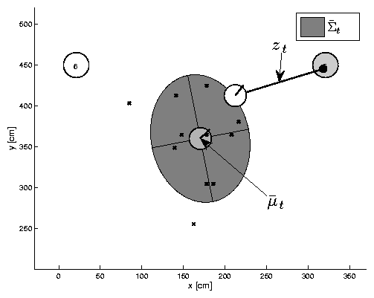
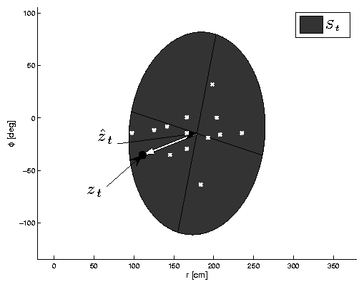
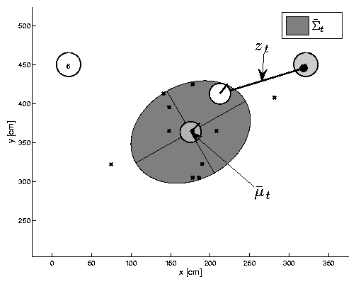
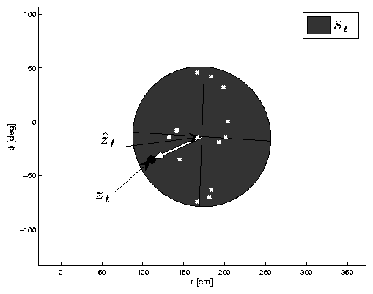
UKF Observation Prediction Step

Slide 16
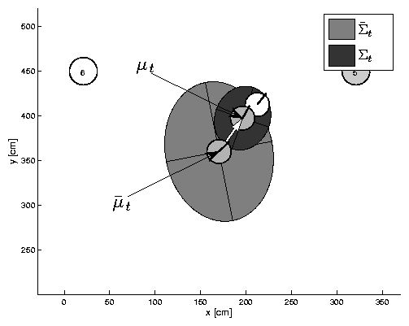
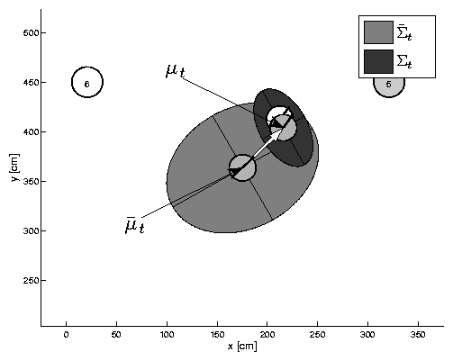
UKF Correction Step

Slide 17
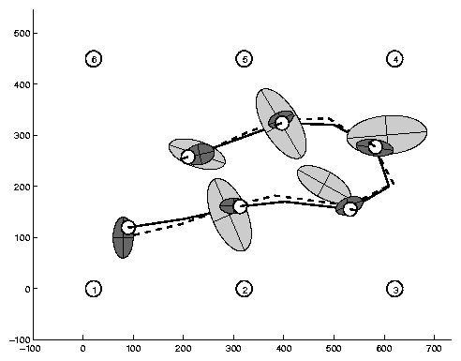
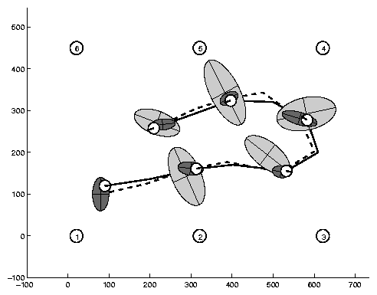
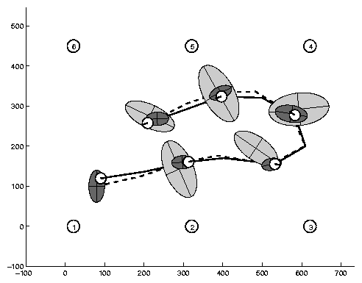
Estimation Sequence
EKF PF UKF

Slide 18
Estimation Sequence
EKF UKF

Slide 19
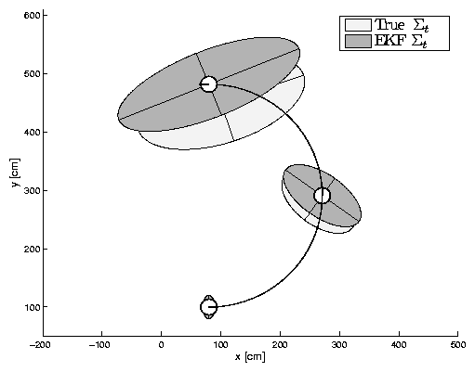
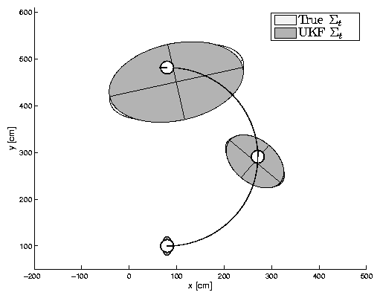
Prediction Quality
velocity_motion_model
EKF UKF

Slide 20
UKF Summary
Highly efficient: Same complexity as EKF, with a constant factor slower in typical practical applications
Better linearization than EKF: Accurate in first two terms of Taylor expansion (EKF only first term)
Derivative-free: No Jacobians needed
Still not optimal!

